Slide 1

BC2410, Prescriptive Analytics From Data to Decisions
Lecture 9

Slide 2
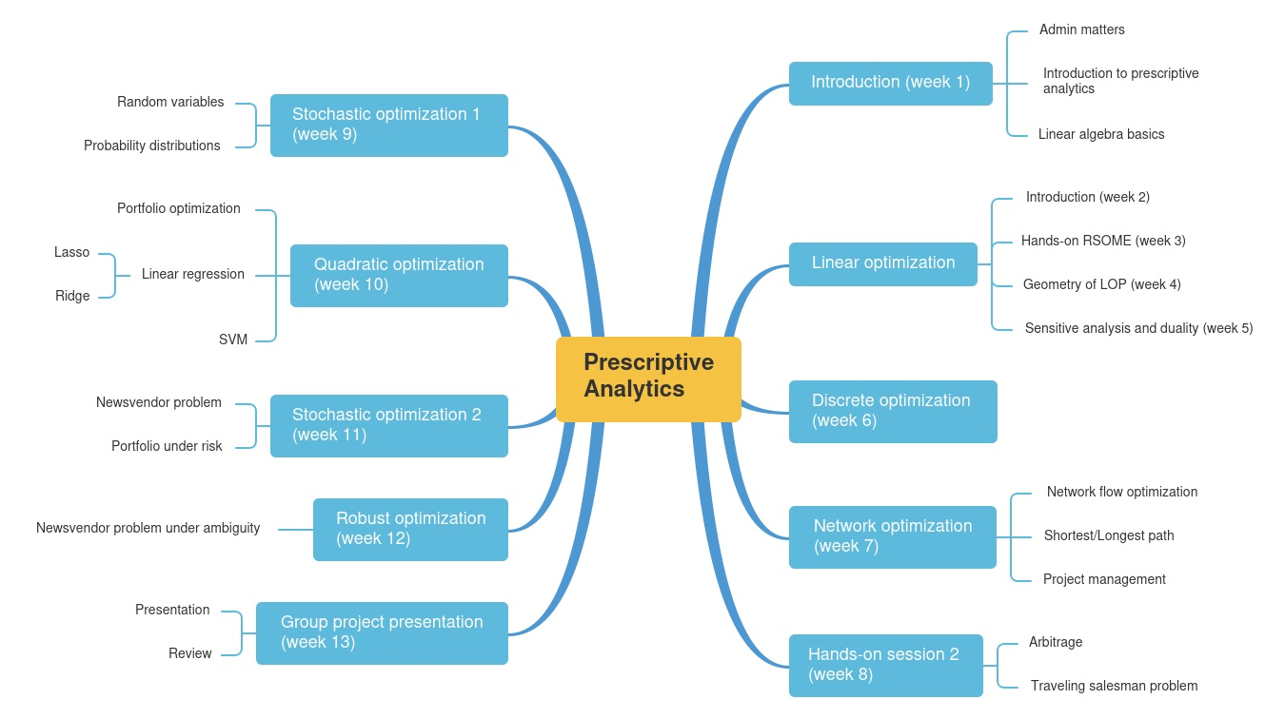
Schedule

Slide 3
Schedule

Slide 4
Random Variables
A random variable is a rule that assigns a numerical value to each possible outcome of a probabilistic experiment.
A random variable (r.v.) may be discrete or continuous.
Discrete
: can only assume values that are distinct and separate
Example 1 : 0, 1, 2, 3, 4, 5, . . .
Example 2 : 2.0, 2.5, 3.0, 3.5
Continuous :
can take on any value within some interval of numbers
Examples : [ 0 , 100 ], [ 2 , 4 ]

Slide 5
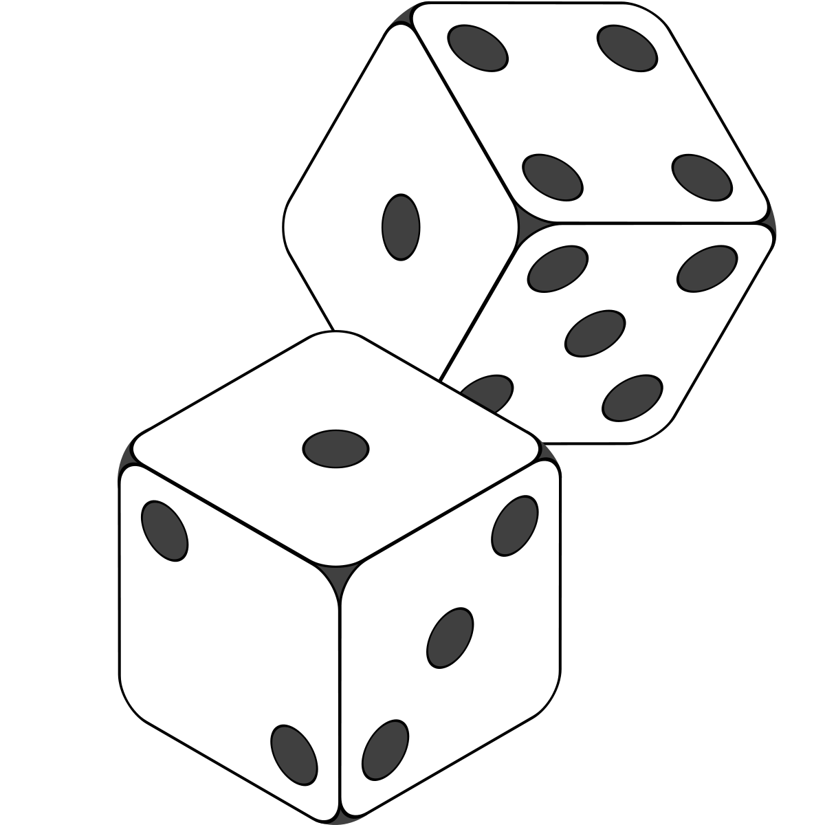

Random Variables
A random variable is a rule that assigns a numerical value to each possible outcome of a probabilistic experiment.
A random variable (r.v.) may be discrete or continuous.
Examples
Total number of points in a throw of 2 dice
Number of B’s you will score in this semester
Time between this and the next slide
Time that you need to wait for buying Xiao Long Bao
Temperature tomorrow
Results for 4D/toto

Slide 6
Probability Distribution
A random variable is a rule that assigns a numerical value to each possible outcome of a probabilistic experiment.
A probability distribution for a random variable describes how probabilities are distributed over the values of the random variable

Slide 7
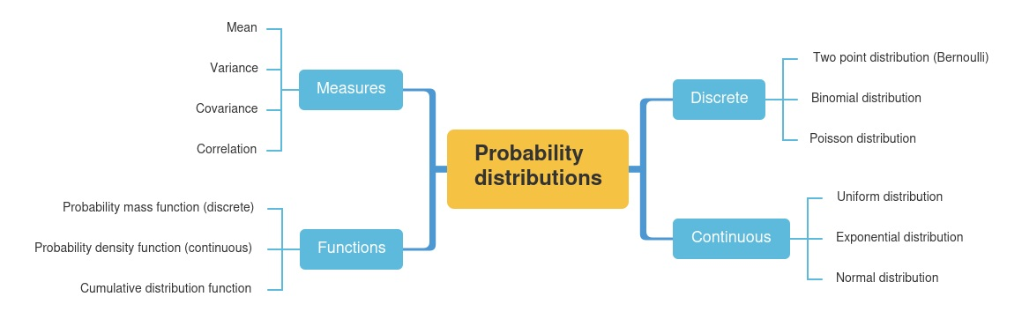
Probability Distribution

Slide 8
Discrete Probability Distribution
A probability distribution for a discrete random variable X consists of
(i) possible values x₁, x₂, . . . , x_{n}
(ii) corresponding probabilities p₁, p₂, . . . , p_{n}
with the interpretation that
ℙ[X = x₁] = p₁, ℙ[X = x₂] = p₂, . . . , ℙ[X = x_{n}] = p_{n}
Note:
Probabilities must sum to 1 : p₁ + p₂ + . . . + p_{n} = 1.0 (p_{i} ≥0)

Slide 9

Discrete Probability Distribution
Let X be the random variable that denotes the number of orders for Boeing 767 aircraft for next year.
Suppose that the number of orders for Boeing 767 aircraft for next year is estimated to obey the following distribution:
Orders for Boeing 767 Aircraft next year x_{i} | Probability pi
42 | 0.05
43 | 0.10
44 | 0.15
45 | 0.20
46 | 0.25
47 | 0.15
48 | 0.10

Slide 10

Where do probability distributions come from?
Empirically (from data)
Example: KFC sells chicken in “buckets” of 2, 3, 4, 8, 12, 16 or 20 pieces. Over the last week, orders for fried chicken had the following data:
pieces in order | orders
2 | 170
3 | 200
4 | 260
8 | 165
12 | 120
16 | 50
20 | 35
 | 1,000
Let X = number of pieces of chicken in an order. Develop a probability distribution for X.

Slide 11
Visualization of Probability Distributions
A histogram is a display of probabilities as a bar chart
Probability Distribution of the
Number of Orders of Boeing 767 Aircraft Next Year
0.35
0.30
0.25
0.20
0.15
0.10
0.05
0.00
Probability
43
44
45 46
Number of Orders
47
48

Slide 12
Measures of Probability Distributions
X and Y denote the sales next year in the eastern division and the western division of a company, respectively.
Eastern Division
Probability Distribution Function of Eastern Division Sales
Sales ($million) | Probability
3.0 | 0.05
4.0 | 0.20
5.0 | 0.35
6.0 | 0.30
7.0 | 0.10
8.0 | 0.00
0.40
0.35
0.30
0.25
0.20
0.15
0.10
0.05
0.00
Probability
3.0
4.0 5.0 6.0 7.0
Sales ($ million)
8.0
Western Division
Probability Distribution Function of Western Division Sales
Sales($million) | Probability
3.0 | 0.15
4.0 | 0.20
5.0 | 0.25
6.0 | 0.15
7.0 | 0.15
8.0 | 0.10
0.40
0.35
0.30
0.25
0.20
0.15
0.10
0.05
0.00
Probability
3.0
4.0 5.0 6.0 7.0
Sales ($ million)
8.0

Slide 13
Measures of Probability Distributions
Summary statistics are used to summarize a set of observations, in order to communicate the largest amount as simply as possible.
Statisticians commonly try to describe the observations in
a measure of location, or central tendency, such as the mean, median, mode etc
a measure of statistical dispersion like the standard deviation, variance, range etc
a measure of the shape of the distribution like skewness or kurtosis

Slide 14
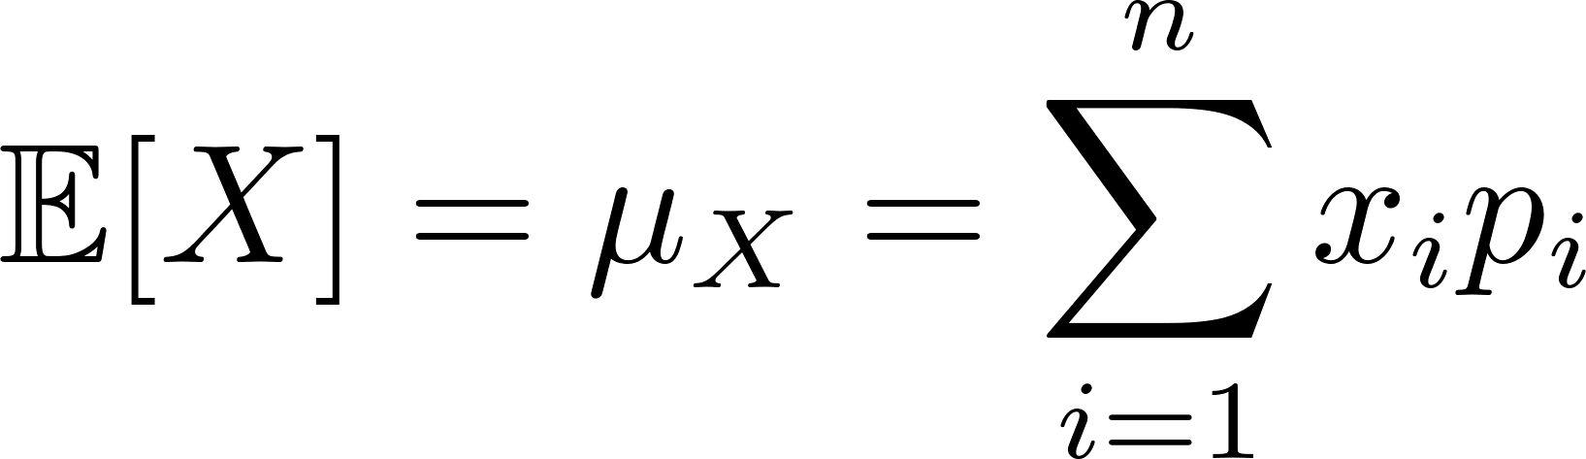
Mean of Probability Distributions
Suppose the discrete r.v. X has probability distribution
x₁, | x₂, . . . , | x_{n}
p₁, | p₂, . . . , | p_{n}
The mean (or expected value) of X is
Notes:
Central value of a finite set of values

Slide 15
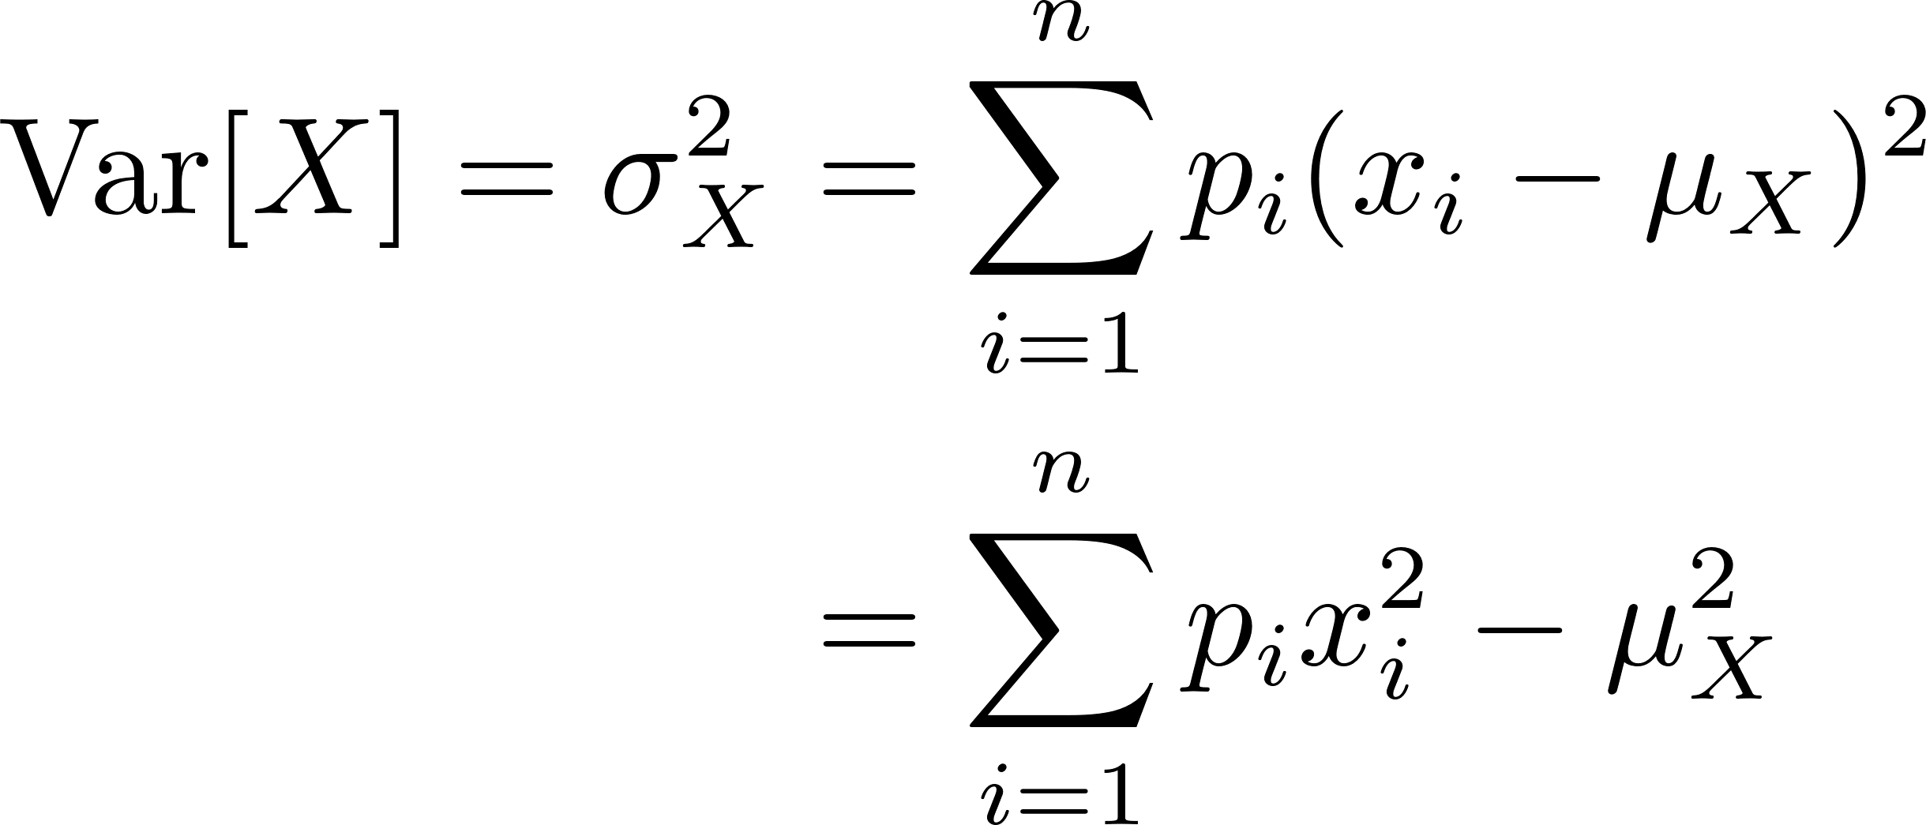
Variance of Probability Distributions
Suppose the discrete r.v. X has probability distribution
x₁, | x₂, . . . , | x_{n}
p₁, | p₂, . . . , | p_{n}
The variance of X is

Slide 16
Discrete Probability Distribution
X and Y denote the sales next year in the eastern division and the western division of a company, respectively.
Eastern Division
Probability Distribution Function of Eastern Division Sales
Sales ($million) | Probability
3.0 | 0.05
4.0 | 0.20
5.0 | 0.35
6.0 | 0.30
7.0 | 0.10
8.0 | 0.00
0.40
0.35
0.30
0.25
0.20
0.15
0.10
0.05
0.00
Probability
3.0
4.0 5.0 6.0 7.0
Sales ($ million)
8.0
Western Division
Probability Distribution Function of Western Division Sales
Sales($million) | Probability
3.0 | 0.15
4.0 | 0.20
5.0 | 0.25
6.0 | 0.15
7.0 | 0.15
8.0 | 0.10
0.40
0.35
0.30
0.25
0.20
0.15
0.10
0.05
0.00
Probability
3.0
4.0 5.0 6.0 7.0
Sales ($ million)
8.0

Slide 17
Covariance and Correlation
How do we summarize the relationship between two variables? Specifically : how do we summarize what we observe in a scatter plot?
Examples:
Unemployment rate | vs. | Crime rate
Stock market Time spent on BC2410 | vs. vs. | Property market BC2410 exam marks

Slide 18

Covariance and Correlation
Example: Starbucks sells gourmet hot coffees and cold beverages. From past sales data, daily sales at North Spine obey the following probability distribution for (X, Y),
X = # hot coffees, Y = # cold beverages sold per day
Probability pi | No. of Hot Coffees Sold xi | No. of Cold Drinks Sold yi
0.10 | 360 | 360
0.10 | 790 | 110
0.15 | 840 | 30
0.05 | 260 | 90
0.15 | 190 | 450
0.10 | 300 | 230
0.10 | 490 | 60
0.10 | 150 | 290
0.10 | 550 | 140
0.05 | 510 | 290
Mean | 444 | 205
Standard Deviation | 244.62 | 145.72

Slide 19
Covariance and Correlation
From the plot, we can conclude that the sales of hot coffees and the sales of cold beverage are negatively related.
Is it correct?

Slide 20
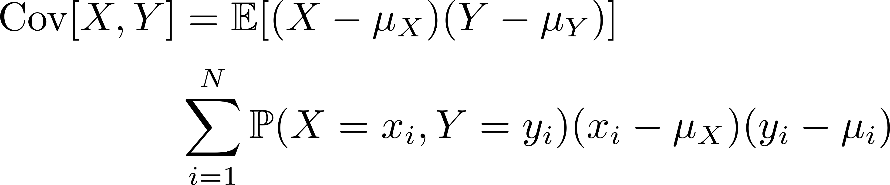
Covariance and Correlation
We now define the covariance of two random variables X and Y with means μ_{X} and μ_{Y} :
Probability | X | Y
ℙ[X = x1, Y = y1 ] | x1 | y1
ℙ[X = x2, Y = y2 ] | x2 | y2
… | … | …
ℙ[X = xN, Y = yN ] | xN | yN
Covariance

Slide 21

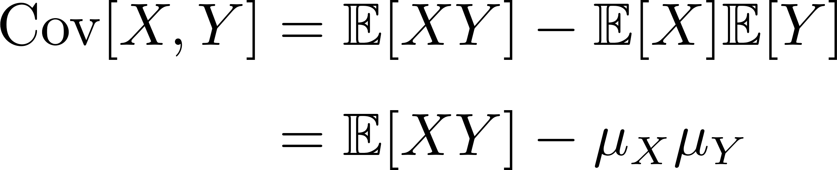
Covariance and Correlation
Covariance
Observe from the above that:

Slide 22

The bigger the covariance is, the stronger the relationship is.
Is it true?

Slide 23
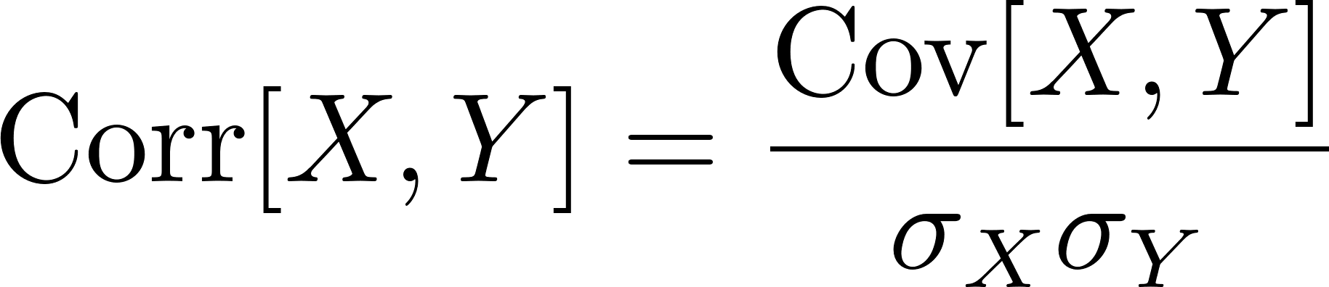
Covariance and Correlation
Covariance
We introduce a standardized measure of interdependence between two rv’s :
Correlation
Properties :
The measure of correlation is unit-free.
Corr[X, Y] is always between 0 and 1
Notes:
The second property can be proved by using Cauchy–Schwarz inequality

Slide 24
Covariance and Correlation
Correlation
Corr[X,Y] = 1.0 perfect positive linear relationship
= 0 no linear relationship between X and Y
= - 1.0 perfect negative linear relationship

Slide 25
Covariance and Correlation
If higher than average values of X are apt to occur with higher than average values of Y, then Cov[X, Y ] > 0 and Corr[X, Y ] > 0.
X and Y are positively correlated.
If higher than average values of X are apt to occur with lower than average values of Y, then Cov[X, Y ] < 0 and Corr[X, Y ] < 0.
X and Y are negatively correlated.

Slide 26
Bernoulli Distribution

Slide 27
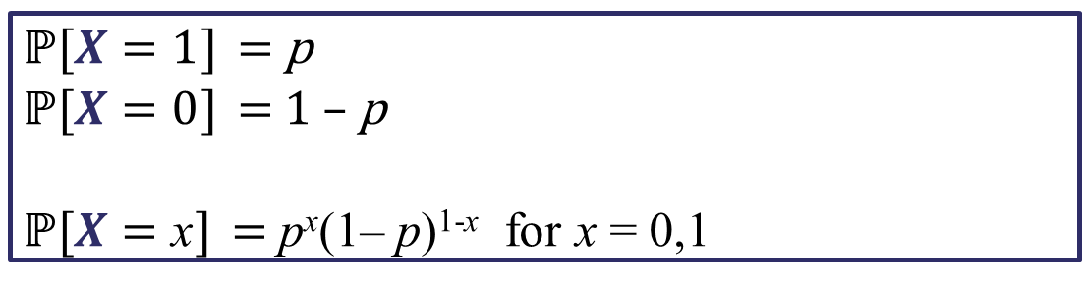
Bernoulli Distribution
1 trial
Has exactly two outcomes : “success” or “failure”
Success p, failure 1 – p
$\text{ℙ}\text{[}$𝑿 = 1] = p
$\text{ℙ}\text{[}$𝑿 = 0] = 1 – p
$\text{ℙ}\text{[}$𝑿 = x] = p^{x}(1– p)^{1-x} for x = 0,1
Notes:
n factorial
Some common distributions

Slide 28

Bernoulli Distribution
1 trial
Has exactly two outcomes : “success” or “failure”
Success p, failure 1 – p
$\text{ℙ}\text{[}$𝑿 = x] = p^{x}(1– p)^{1-x} for x = 0,1
Mean:
Variance:
Notes:
n factorial
Some common distributions

Slide 29
Binomial Distribution
n independent trials
Each trial has exactly two outcomes : “success” or “failure”
Each trial has same probability: success p, failure 1 – p

Slide 30
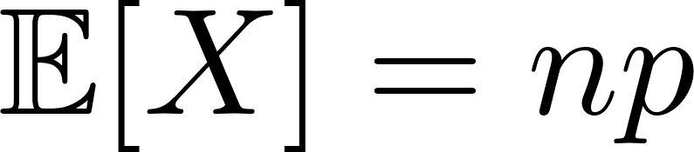
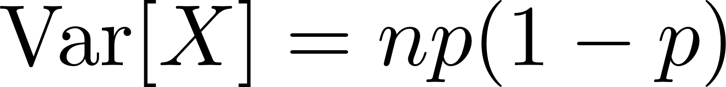
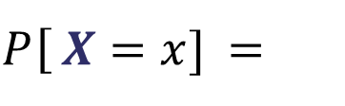
Binomial Distribution
$P$[𝑿 = 𝑥] =
𝑛 !
𝑝^{𝑥} (1 − 𝑝)^{𝑛−𝑥}
for 𝑥 = 0, 1, . . . , 𝑛
𝑥! 𝑛−𝑥 !
We also say that X obeys a binomial distribution with parameters n and p : Binomial (n, p) or B(n,p)
Probability mass function (pmf)
Binomial Distribution
Mean:
Variance:
Notes:
combinations

Slide 31
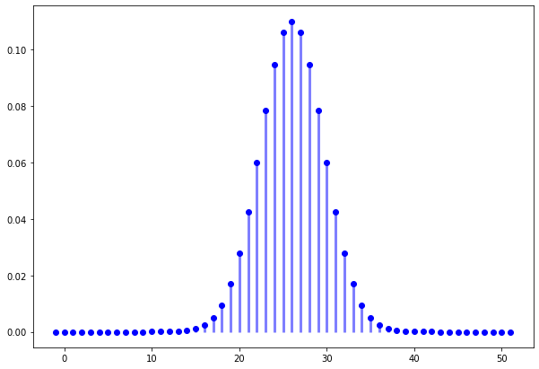
Probability Mass Function (pmf)

Slide 32
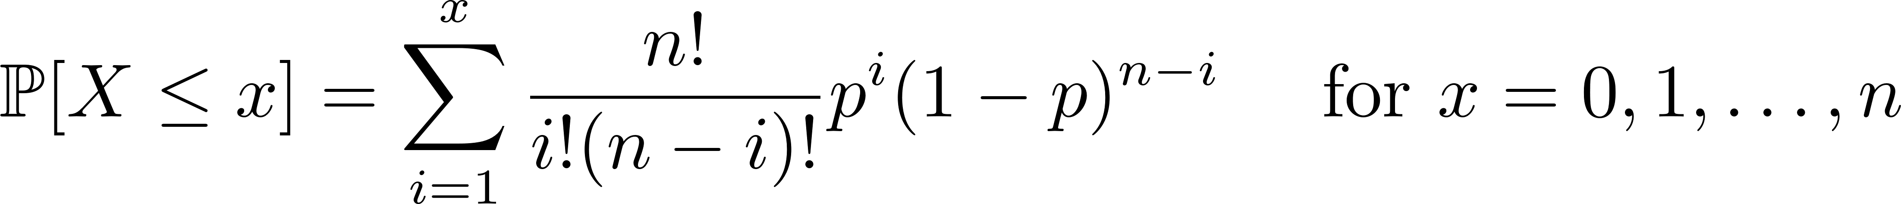
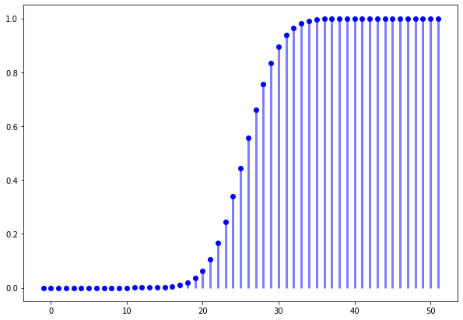
Cumulative Distribution Function (cdf)

Slide 33
Application of Binomial Distribution

Slide 34

It all starts with a mysterious phone call…
Hi Dear friend. This is Mike.
I am an investment broker from the T.Q.S. Company.
… Yes! T.Q.S. Now you remember ah. The T.Q.S. loh.
I have a very good news to share with you.
We have done a very thorough research on 400 mutual funds.
You know what? We found a star fund that has beaten a standard market index in 37 out of 52 weeks.

Slide 35
It all starts with a mysterious phone call…
YES! 37 out of 52 weeks!
If you invested in this fund, a simple math can tell you how much you can earn.
Your math must be good, right? Sure one… So… why bother studying so hard?
Invest with me and you will be rich soon.

Slide 36
Question 1
We say a fund beats the market purely by chance if each week the fund has a fifty-fifty chance of beating the market index, independently of its performance in other weeks.
What is the probability for such fund to beat the market at least 37 out of 52 weeks?

Slide 37
Question 2
Suppose that all the 400 funds beat market purely by chance. What is the probability that the best of them beats the market at least 37 out of 52 weeks?
Conclusion?

Slide 38
Poisson Distribution

Slide 39
Poisson Distribution
It all starts with Mala Beef La Mian …

Slide 40
Poisson Distribution
Due to the outbreak of COVID-19, many students chose not to have their lunch or dinner at South Canteen. The cook of Xiao Long Bao didn’t know how many Mala Beef La Mian to prepare, so he collected some lunch data for the first week:
What is the probability of selling k MBLM during lunch time?
 | # of MBLM sold
Mon | 3
Tue | 7
Wed | 4
Thu | 6
Fri | 5

Slide 41
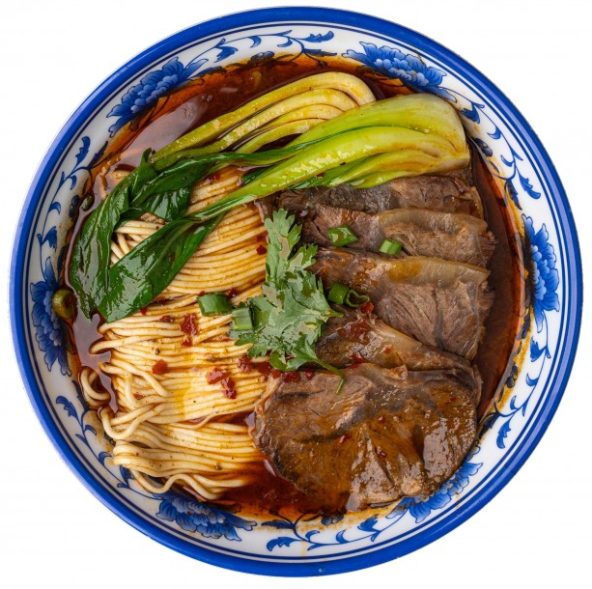
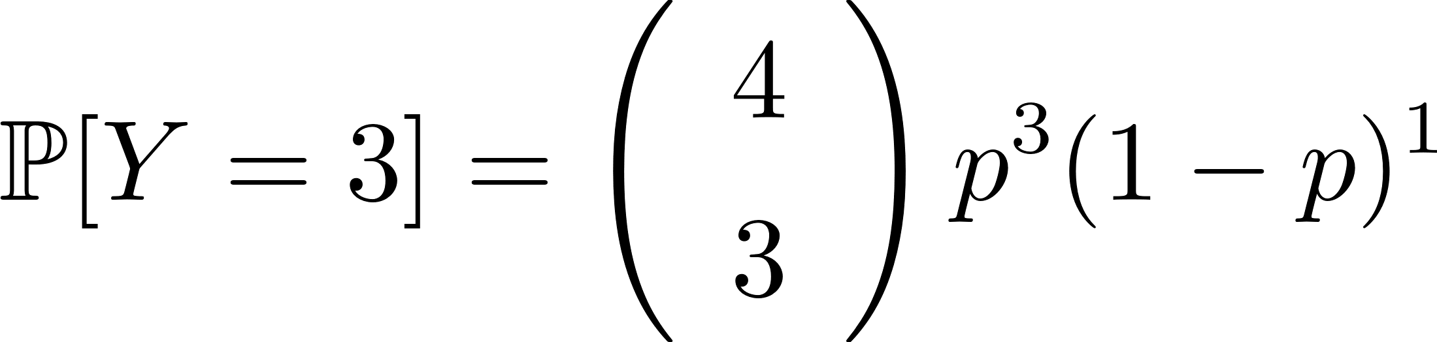
Poisson Distribution
 | # of MBLM sold
Mon | 3
Tue | 7
Wed | 4
Thu | 6
Fri | 5
11:00
Yes
Yes
Yes
No
14:00
T
p: probability of selling one MBLM in each interval
Y: number of intervals that have 1 MBLM sold

Slide 42
Poisson Distribution
11:00
14:00
T

Slide 43
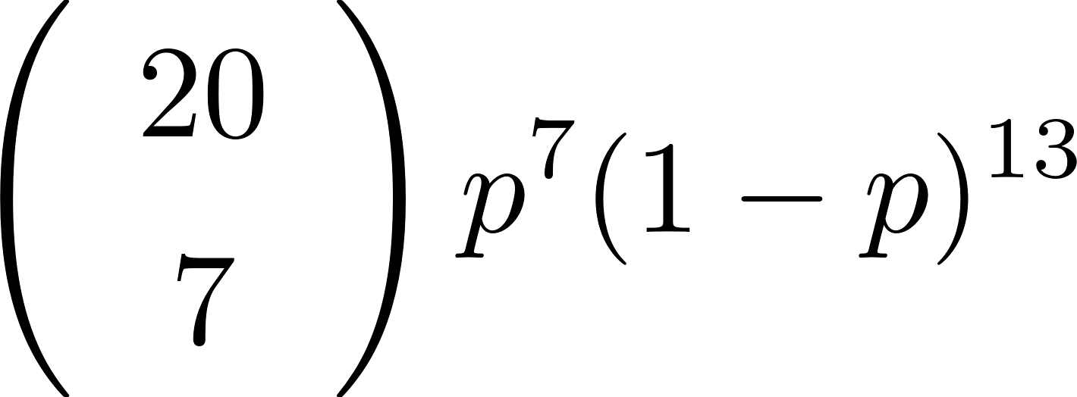
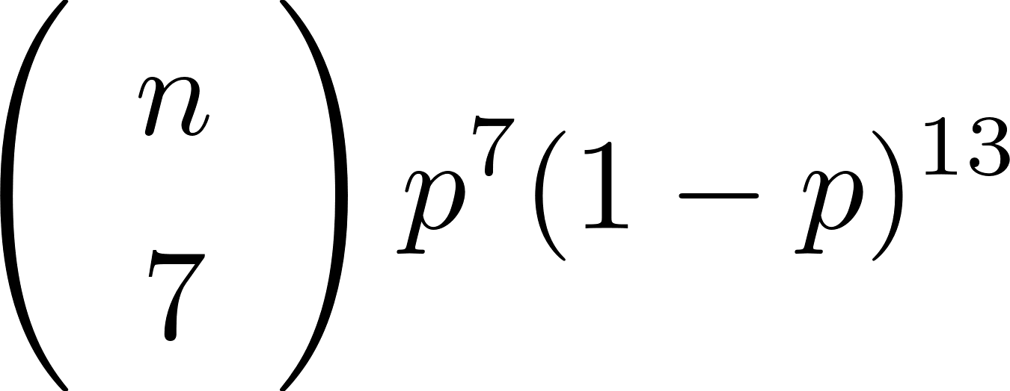
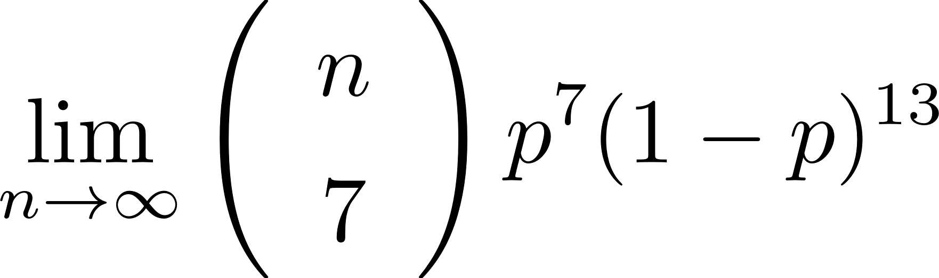
Poisson Distribution
11:00
14:00
T

Slide 44
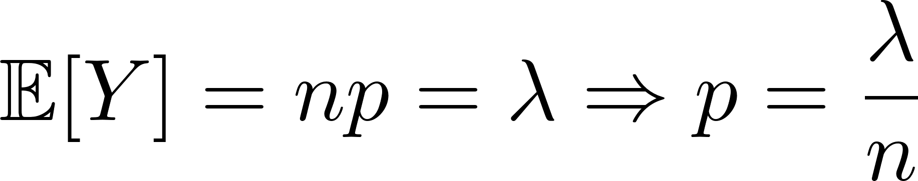
Poisson Distribution
11:00
14:00
T
How to obtain the probability p?

Slide 45
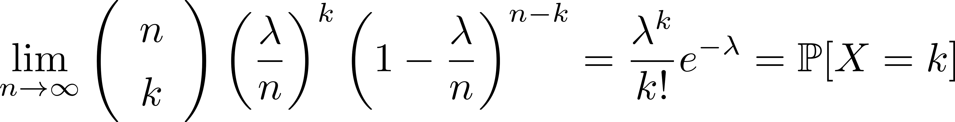
Poisson Distribution
11:00
14:00
T
This is the probability of selling k Mala Beef La Mian within time T!!

Slide 46
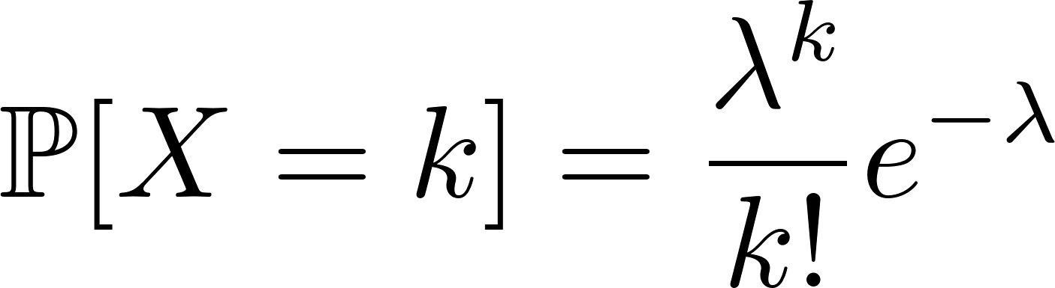
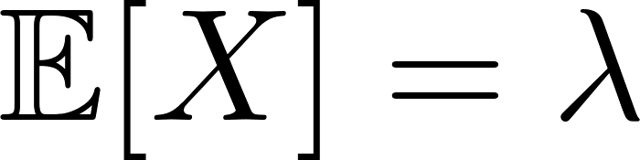
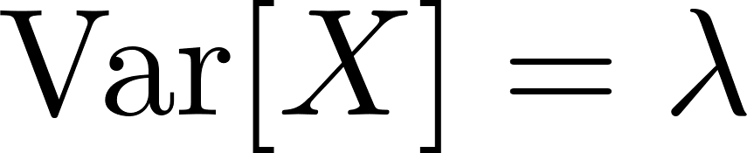
Poisson Distribution
A random variable X is said to be a Poisson r.v. with parameter
λ (> 0) if it has the probability function
Mean:
Variance:

Slide 47
Poisson Distribution
Useful for modelling the number of occurrences of an event over a specified interval of time or space.
Examples :
Number of customer orders received in one hour
Number of failures in a large computer system per month
Properties:
Probability of an occurrence is the same for any two intervals of equal length.
Occurrences in nonoverlapping intervals are independent of one another.

Slide 48
Poisson Distribution
Examples and Applications:
The number of phone calls arriving at a call centre per minute.
The number of goals in sports involving two competing teams.
The number of infant death per year.
The number defaults found per newly TOP flat.
– …

Slide 49
Probability Distribution

Slide 50
Exponential Distribution

Slide 51
Exponential Distribution
… …
T₁
T₂
T₃
T₄
T₅
T_{i}: time interval between event i – 1 and event i
Y = time interval between selling two consecutive MBLMs

Slide 52
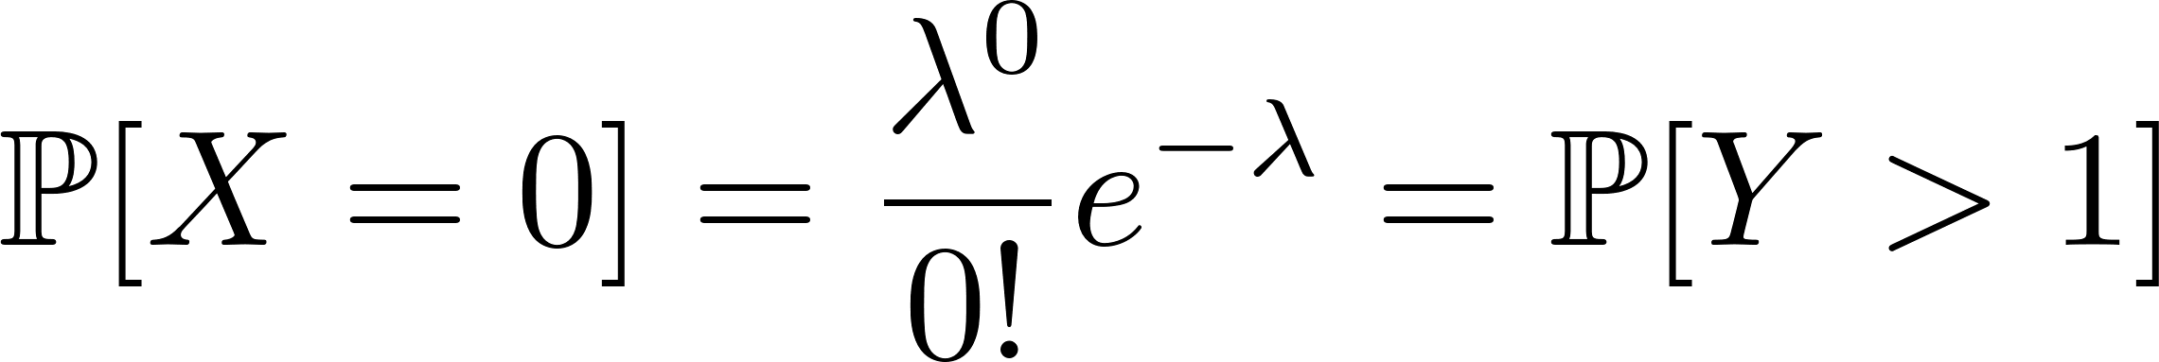
Exponential Distribution
… …
If there is a unit of time that you sell nothing, then your probability is:

Slide 53
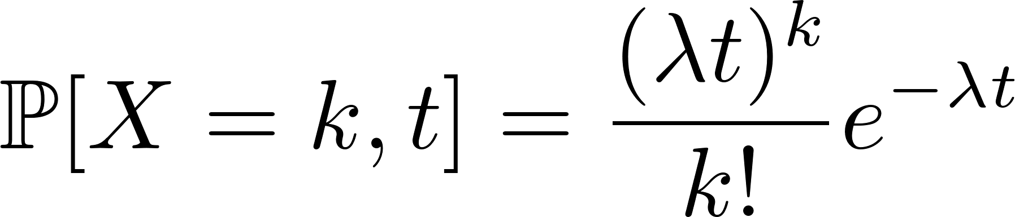
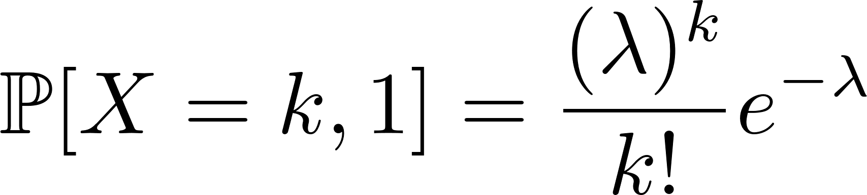

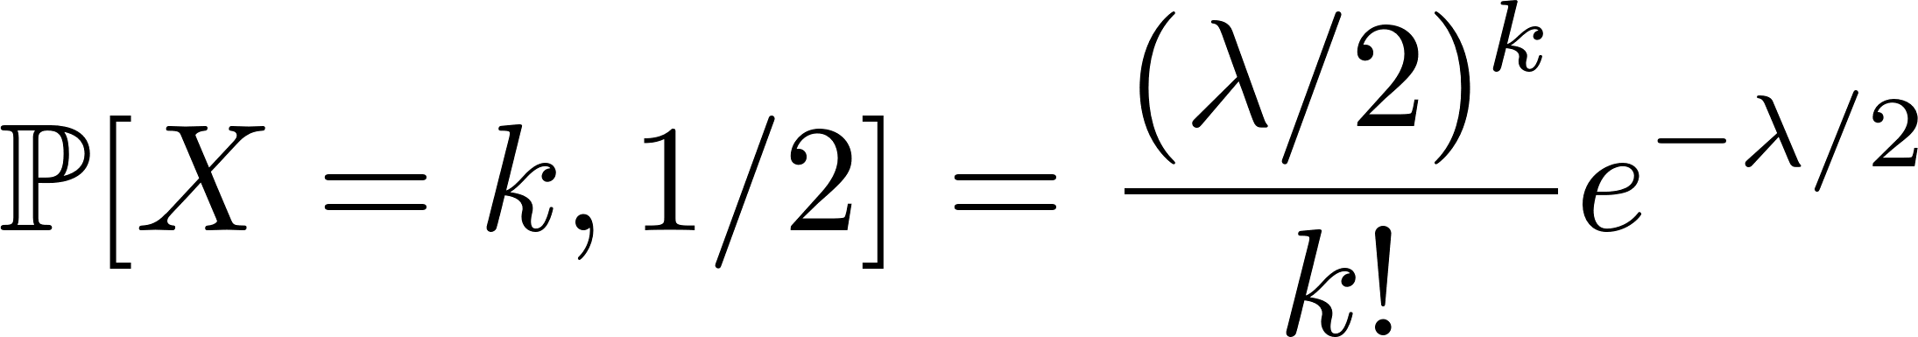

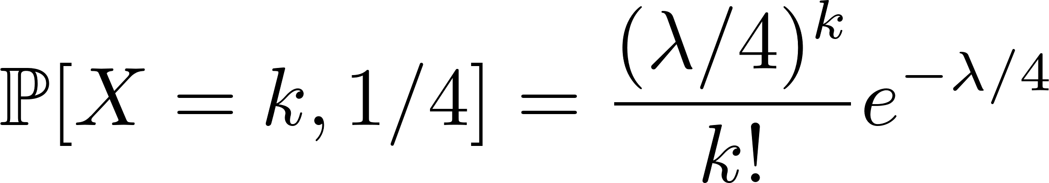
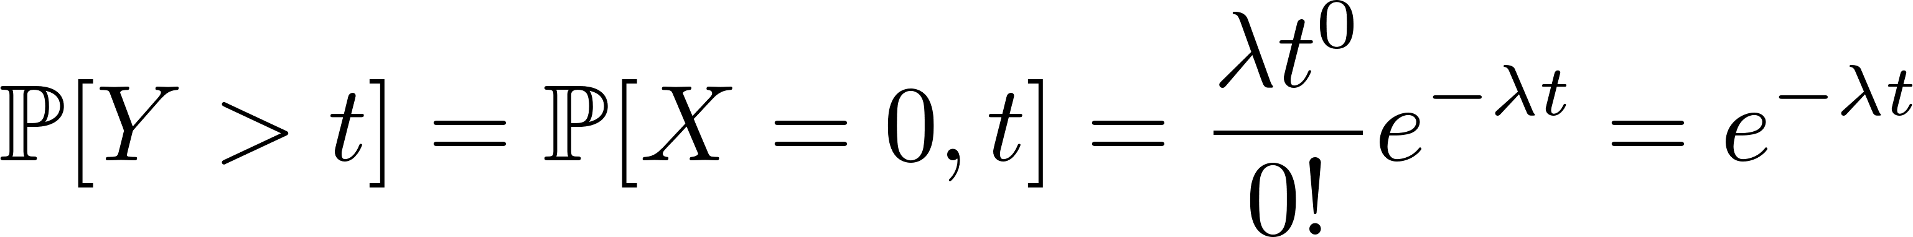
Exponential Distribution (Optional)
 | t
# of item sold every unit of time | 1
# of item sold half unit of time
# of item sold a quarter unit of time
Notes:
This is the Poisson Process (https://en.wikipedia.org/wiki/Poisson_point_process)

Slide 54
Probability Distribution

Slide 55
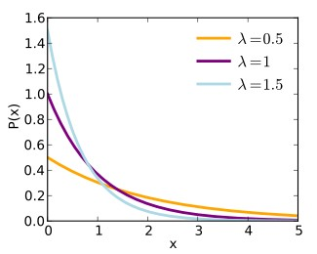
Exponential Distribution
Often arises as the distribution of amount of time until an event occurs.
Useful for waiting line problems.
A random variable X is said to be an exponential r.v. with rate parameter λ ( > 0) if it has the pdf
f ( x ) =λe ^{− λ x} for x > 0

Slide 56
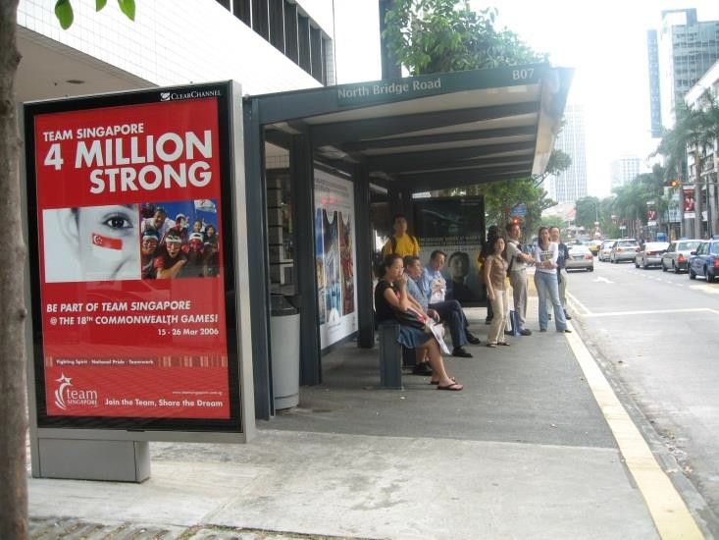
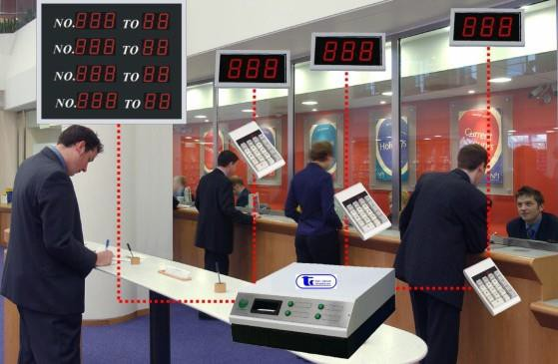

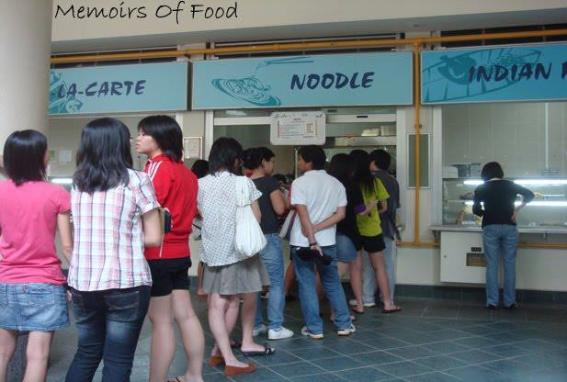
Exponential Distribution

Slide 57
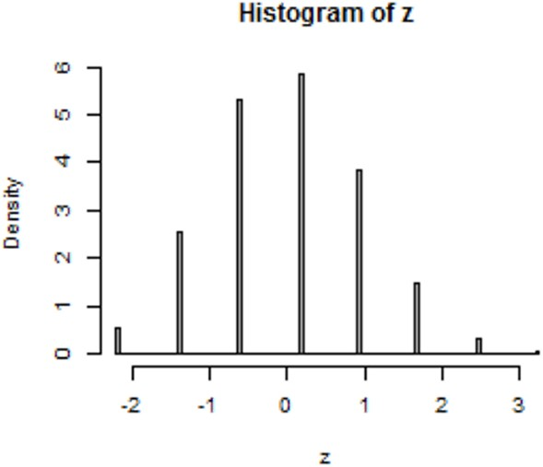
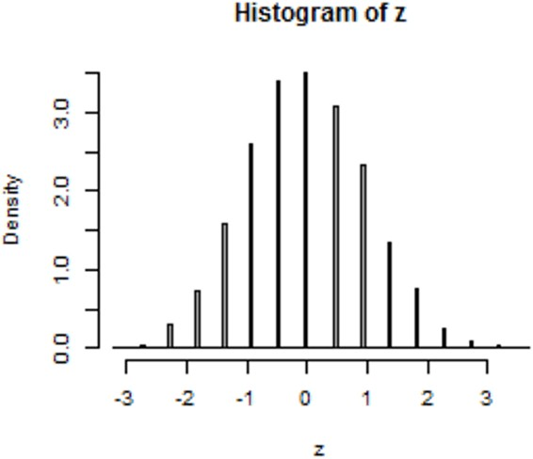
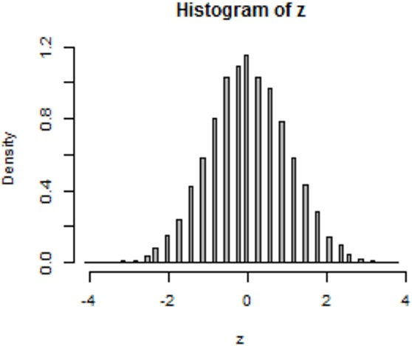
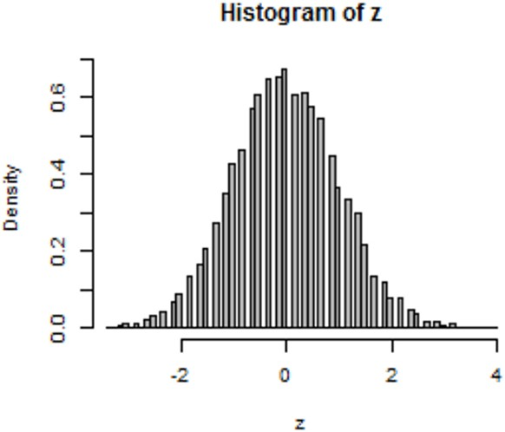
Histogram

Slide 58
Probability Density Function
We can describe the probability distribution of a continuous r.v. X by its probability density function (pdf), usually denoted by f ( x ) .
f (x)
x

Slide 59
Probability Density Function
The probability density function (pdf) of a r.v. X has the following characteristics:
Area under the pdf curve is equal to 1
Probability that X lies between values a and b is equal to the area under the curve between a and b
f (x)
area = ℙ[a ≤ X ≤ b]
x
a
b

Slide 60
Probability Density Function
Given the pdf f(x), how do we compute the area under the curve between a and b?
In general, we will have to evaluate the integral
f (x)
area = ℙ[a ≤ X ≤ b]
x
a
b

Slide 61
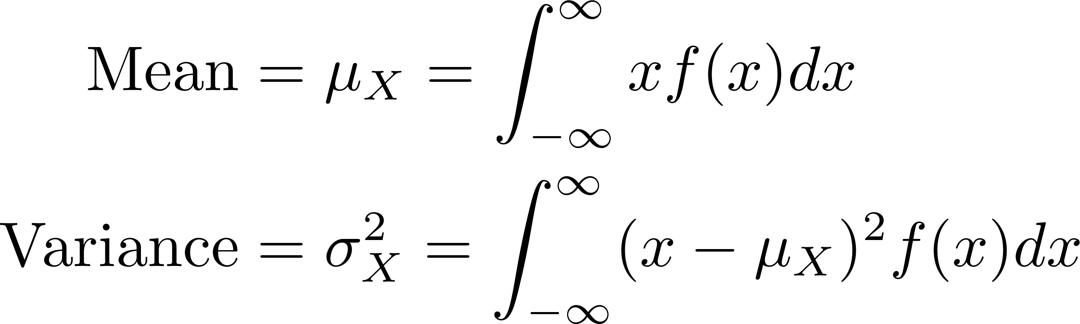
Probability Density Function
Given the pdf f(x), how do we compute the mean and variance of X ?
f (x)
x

Slide 62
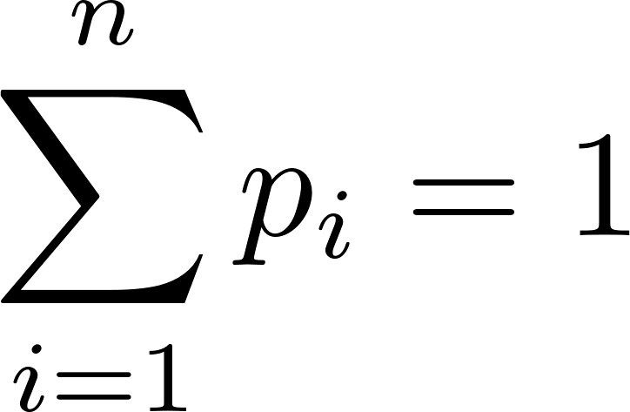
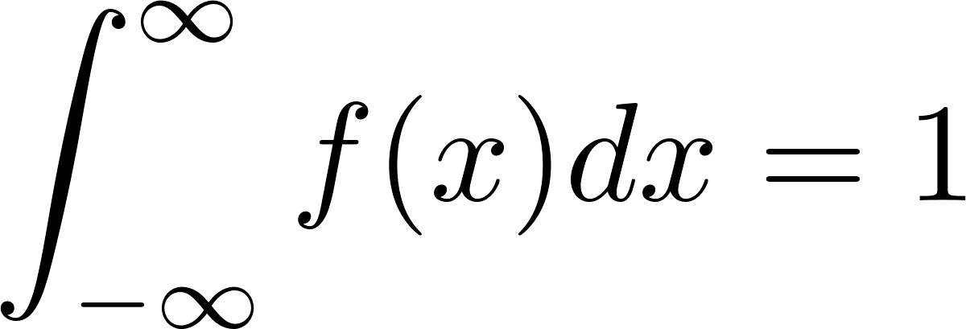
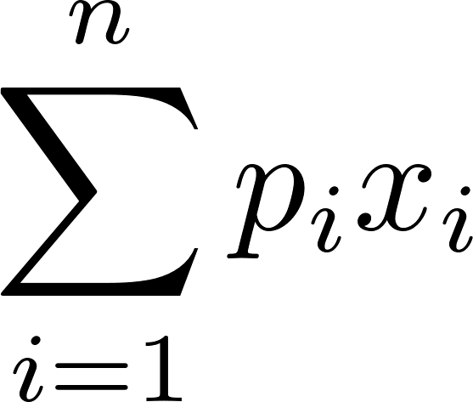
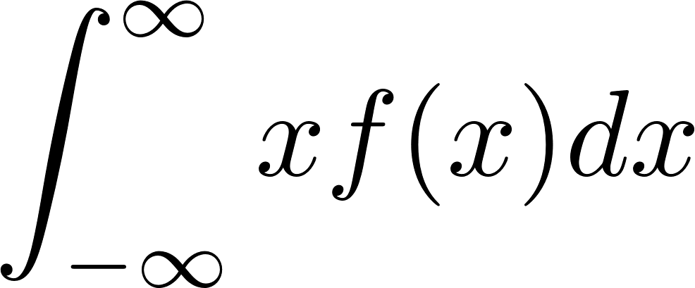
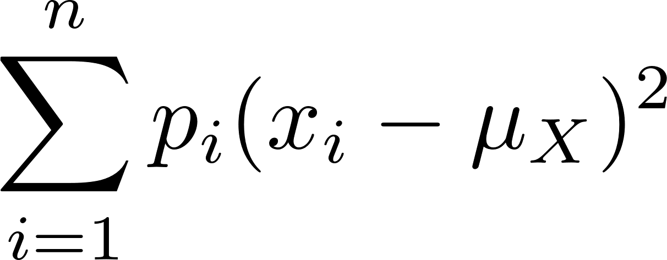
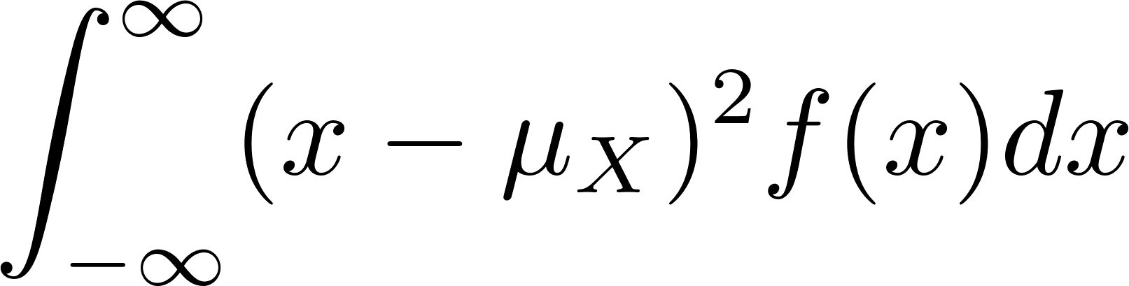
Discrete vs. Continuous
 | Discrete | Continuous
Probability distribution |  | pdf f ( x )
Mean (μ)
Variance (σ²)
x1 | p1
x2 | p2
x_{n} | pn

Slide 63
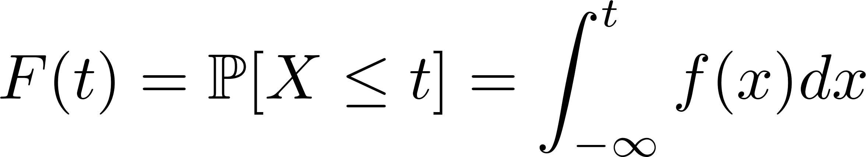
Cumulative Distribution Function
For a given t, the cumulative distribution function
(cdf) F(t) of a continuous r.v. X is defined by
F(t) is the probability that X does not exceed t.
f (t)
By definition :
0 ≤ F(t) ≤ 1
F(t) is a non-decreasing
function of t
ℙ[X ≤ t]
t

Slide 64
Cumulative Distribution Function
For a given t, the cumulative distribution function
(cdf) F(t) of a continuous r.v. X is defined by
It is also easy to see that :
ℙ[X >t ] = 1– F(t)
ℙ[c <X <d ]=F(d)–F(c)
Note: ℙ[X ≤ t]=ℙ[X<t]

Slide 65
Exponential Distribution
Often arises as the distribution of amount of time until an event occurs.
Useful for waiting line problems.
A random variable X is said to be an exponential r.v. with rate parameter λ ( > 0) if it has the pdf
f ( x ) =λe ^{− λ x} for x > 0

Slide 66
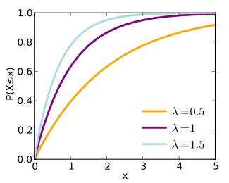
Exponential Distribution
It can be shown that
Mean 𝔼[ X] =
Variance Var[X ] =
1
𝝀 1
_{𝝀}2
It can be shown that
X has the cdf
𝐹( x )=1 − 𝑒^{−𝝀𝒙}

Slide 67
Exponential Distribution
Suppose the usage duration of a particular ATM is an exponential r.v. with a mean of 3 mins. If someone arrives at the ATM immediately ahead of you, find the probability that you have to wait
(a) more than 2 minutes, and
(b) between 2 and 3 minutes
X = usage duration (in mins) of ATM is exponential r.v. with parameter λ = 1/3.

Slide 68
Uniform Distribution

Slide 69
Uniform Distribution
Uniform Distribution
X is “uniform” on [a,b] if X is equally likely to take any value in the range from a to b.
f (t)
a
b
t

Slide 70
Example
Suppose that travel time (by bus) between Pioneer and NBS is uniformly distributed between 12 and 20 minutes.
What is the mean travel time?
What is the probability that the travel time exceeds 14 minutes?
What is the probability that the travel time is between 14 and 18 minutes?

Slide 71
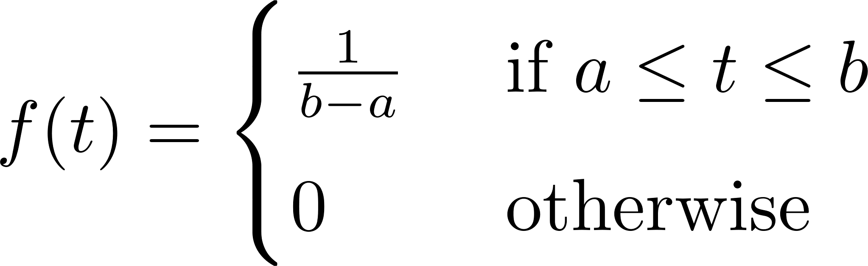
Uniform Distribution
If the r.v. X is equally likely to take any value in the range from a to b (where b > a), then we say that X obeys a uniform distribution over [a,b].
We write : X ∼ U[a,b]
Equation of f(t) ?
f (t)
1/(b–a)
area = 1
a
b
t

Slide 72
Uniform Distribution
If the r.v. X is equally likely to take any value in the range from a to b (where b > a), then we say that X obeys a uniform distribution over [a,b].
We write : X ∼ U[a,b]
CDF of X ?
f (t)
1/(b–a)
area = 1
a
b
t

Slide 73
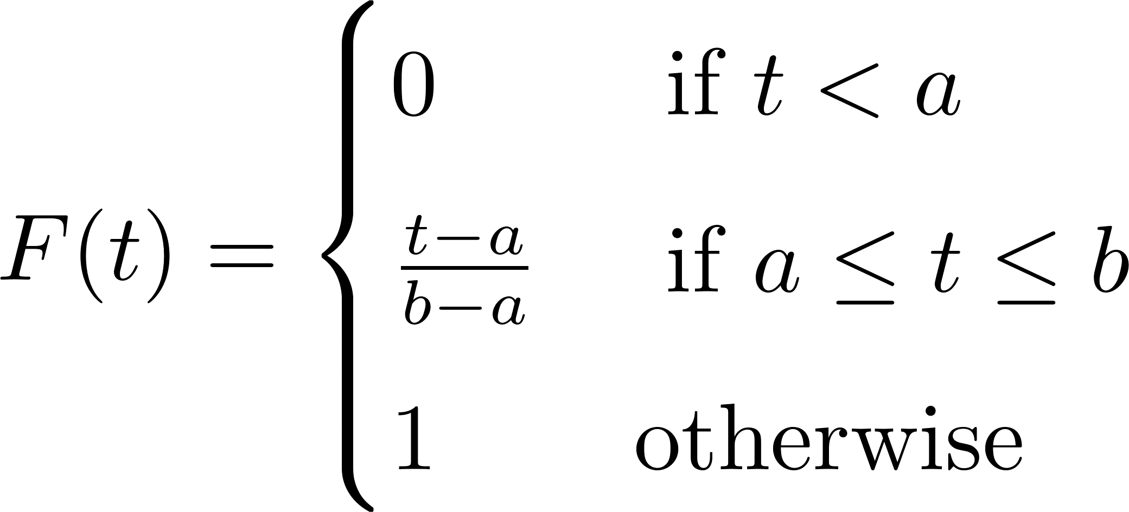
Uniform Distribution
If the r.v. X is equally likely to take any value in the range from a to b (where b > a), then we say that X obeys a uniform distribution over [a,b].
We write : X ∼ U[a,b]
CDF of X ?
f (t)
1/(b–a)
area = 1
a
b
t

Slide 74


Uniform Distribution
If the r.v. X is equally likely to take any value in the range from a to b (where b > a), then we say that X obeys a uniform distribution over [a,b].
We write : X ∼ U[a,b]
Mean and var of X ?
f (t)
1/(b–a)
area = 1
a
b
t

Slide 75



Example
The men’s 100 meter sprint at the 1996 Olympic Games in Atlanta was a hotly contested event between three athletes.
Donovan Bailey
(Canada)
Frankie Fredericks
(Namibia)
Ato Boldon (Trinidad)

Slide 76
Example
Assume that the probability distribution of the time to run the race is the same for the three, and that this time obeys a uniform distribution between 9.75 seconds and 9.95 seconds.
What is the probability that Donovan’s time will beat the previous record of 9.86 seconds?
What is the probability that the winning time will beat the previous records of 9.86 seconds?

Slide 77
Normal Distribution

Slide 78


Normal Distribution
Density function is the familiar bell-shaped curve
f(t)
t
μ
A r.v. X that obeys a Normal distribution is completely described by
two parameters : mean µ and standard deviation σ.
We write : X ∼ N(µ,σ).
f(t) is symmetric around the mean
f(t) is highest at its mean
Note:

Slide 79

Normal Distribution
PDFs of 4 Normally distributed r.v’s

Slide 80
Normal Distribution
Many phenomena obey the Normal distribution:
PSLE scores
Height of a group of people (e.g., NBS students)
Stock return over short periods of time
Width of steel plate from a production process
Consumer demand for a product on a given day
But ... some phenomena are not Normally distributed:
Stock returns over longer periods of time
Income distributions

Slide 81
Computing Probabilities for Normal Distributions
Suppose :
X ∼ N(100,25)
How do we compute probabilities such as :
ℙ[ 75 ≤ X ≤ 125 ]
ℙ[ 50 ≤ X ≤ 150 ]
ℙ[ 25 ≤ X ≤ 175 ]
Please use python to obtain the probability.

Slide 82
Normal Distribution
99.72%
95.44%
68.26%
x
μ
μ – 3σ
μ – σ
μ + σ
μ + 3σ
μ – 2σ
μ + 2σ

Slide 83

Are you normal?
The IQ of famous people
Mean = 100 & SD = 15

Slide 84
Real Data Practice
Please load the data “Waiting_Time.csv” and figure out the best fit distributions
Please load the data “Demand_Data.csv” and figure out the best fit distributions

